Slide 1
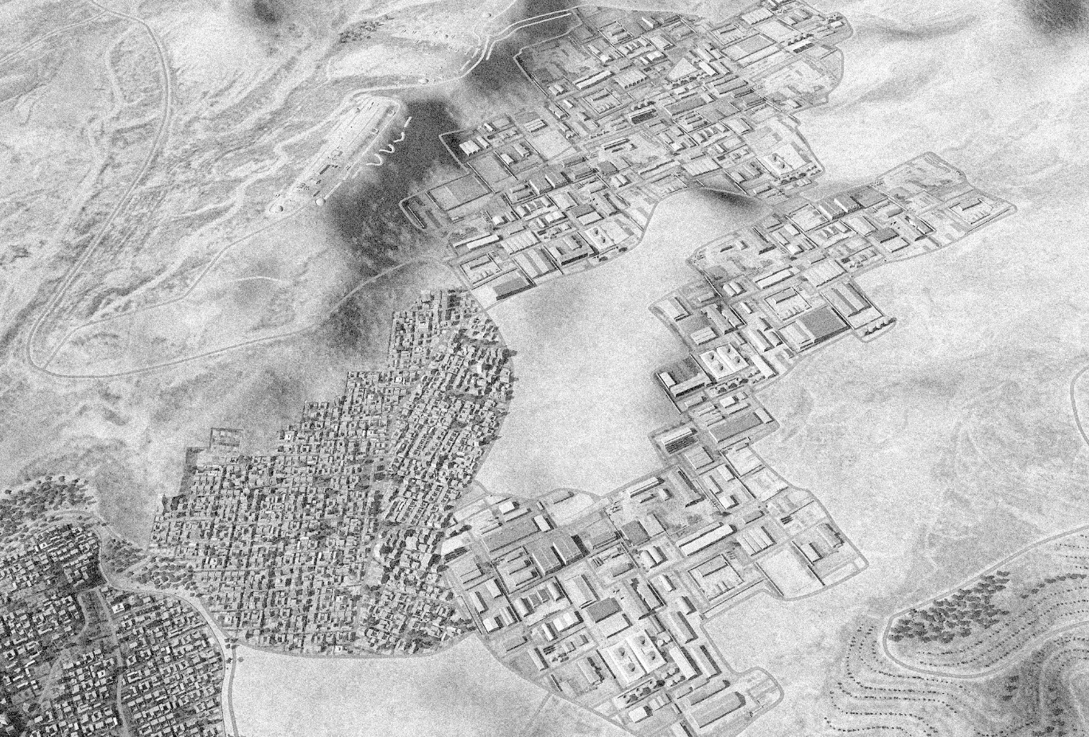
SYTGT027 DAMASCUS N VEHICLE FACTORY
35 36
N
DESIRED POINT of IMPACT:
DPI 36 - N33 33.113 E 36 15.734 / 2724ft / 2000lb PGM
DPI 35 - N33 33.116 E 36 15.686 / 2733ft / 2000lb PGM
DPI 34 - N33 32.976 E 36 15.478 / 2644ft / 2000lb PGM
DPI 33 - N33 32.880 E 36 15.630 / 2650ft / 2000lb PGM
DPI 32 - N33 32.880 E 36 15.598 / 2637ft / 2000lb PGM
DPI 31 - N33 32.800 E 36 15.385 / 2598ft / 2000lb PGM
DPI 30 - N33 32.810 E 36 15.337 / 2577ft / 2000lb PGM
DPI 29 - N33 32.845 E 36 15.335 / 2576ft / 2000lb PGM
DPI 28 - N33 32.817 E 36 15.295 / 2562ft / 2000lb PGM
DPI 27 - N33 32.817 E 36 15.282 / 2557ft / 2000lb PGM
DPI 26 - N33 32.817 E 36 15.261 / 2557ft / 2000lb PGM
DPI 25 - N33 32.817 E 36 15.247 / 2557ft / 2000lb PGM
DPI 24 - N33 32.633 E 36 15.217 / 2608ft / 2000lb PGM
DPI 23 - N33 32.618 E 36 15.082 / 2579ft / 2000lb PGM
DPI 22 - N33 32.394 E 36 15.850 / 3039ft / 2000lb PGM
DPI 21 - N33 32.502 E 36 15.692 / 2868ft / 2000lb PGM
DPI 20 - N33 32.502 E 36 15.678 / 2873ft / 2000lb PGM
DPI 19 - N33 32.502 E 36 15.658 / 2871ft / 2000lb PGM
DPI 18 - N33 32.502 E 36 15.644 / 2865ft / 2000lb PGM
DPI 17 - N33 32.335 E 36 15.555 / 2860ft / 2000lb PGM
DPI 16 - N33 32.335 E 36 15.535 / 2845ft / 2000lb PGM
DPI 15 - N33 32.436 E 36 15.284 / 2815ft / 2000lb PGM
DPI 14 - N33 32.304 E 36 15.481 / 2815ft / 2000lb PGM
DPI 13 - N33 32.327 E 36 15.477 / 2815ft / 2000lb PGM
DPI 12 - N33 32.313 E 36 15.433 / 2797ft / 2000lb PGM
DPI 11 - N33 32.223 E 36 15.266 / 2712ft / 2000lb PGM
DPI 10 - N33 32.223 E 36 15.236 / 2707ft / 2000lb PGM
DPI 9 - N33 32.015 E 36 15.248 / 2813ft / 2000lb PGM
DPI 8 - N33 32.142 E 36 15.020 / 2633ft / 2000lb PGM
DPI 7 - N33 32.216 E 36 14.873 / 2605ft / 2000lb PGM
DPI 6 - N33 32.216 E 36 14.845 / 2605ft / 2000lb PGM
DPI 5 - N33 32.161 E 36 14.926 / 2620ft / 2000lb PGM
DPI 4 - N33 32.161 E 36 14.912 / 2614ft / 2000lb PGM
DPI 3 - N33 32.161 E 36 14.893 / 2606ft / 2000lb PGM
DPI 2 - N33 32.161 E 36 14.879 / 2602ft / 2000lb PGM
DPI 1 - N33 31.892 E 36 14.975 / 2660ft / 2000lb PGM
34
29
30
32
33
25-28
31
18-21
22
24
23
15
16 17
12
13
14
10-11
8
9
6 7
2-5
1
CDC - High density civilian population within 100m of the western part of the complex ( marked in red).
Highly concentrated chemical storage units pose high risk of contamination if struck ( marked in red within complex).

Slide 2
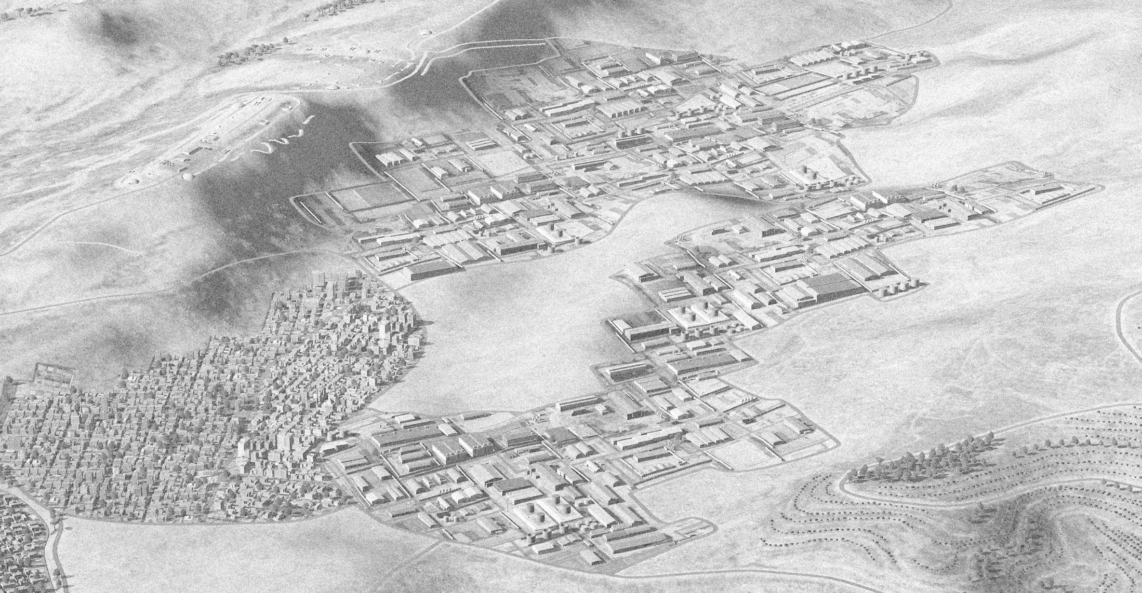
Administration and logistics
N
Assembly Halls
Air Defense Emplacements
Parts manufacturing

